Slide 1

Quantifying Residential Segregation
Boston, Massachusetts
Liz Johnson
Monitoring Cities F22 Final Project

Slide 2
A national survey found that, black people ranked Boston as least welcoming to people of color¹.

Slide 3
Research Objectives
Visualize communities across the city of Boston via racial dot maps
Create a metric to quantify the diversity within neighborhoods across the city
Temporal Analysis
Hypothesis - Segregated neighborhoods in Boston have remained highly segregated. Some diverse neighborhoods have become less diverse due to gentrification
Comparative Analysis against New York City
Hypothesis - On average, New York City neighborhoods are more diverse and integrated compared to Boston.

Slide 4
The Data
Primary data source: American Community Survey 5 year estimates
B03002 - Hispanic or Latino Origin by Race
Years 2013-2020
U.S. Census Bureau cross-tabulates race and Hispanic origin categories to get:
Hispanic
White alone, non-Hispanic
Black or African American alone, non-Hispanic
American Indian and Alaska Native alone, non-Hispanic
Asian alone, non-Hispanic
Native Hawaiian and Other Pacific Islander alone, non-Hispanic
Some Other Race alone, non-Hispanic
Multiracial, non-Hispanic
as the 8 main racial groups^{[2]}

Slide 5
The Methodology
Creating racial dot maps:
Inputs: geometry boundaries of census block groups and counts of population in each racial/ethnic group
Outputs: random point locations for each person in each racial/ethnic group within a given geometry boundary
Iterate over years to see the change of population over time
Notes:
H = 0 means only one species within community, the higher the H the more diverse a community is.
E_H ranges from 0 to 1. 1 indicated complete evenness.

Slide 6
The Methodology
Calculating diversity metric from racial/ethnic counts:
Shannon Diversity Index: a way to measure the diversity of species in a community, calculated by:
H = - Σ p_{i} × ln(p_{i}),
where p_{i} is the proportion of the entire community made up of species i^{[3]}
Notes:
H = 0 means only one species within community, the higher the H the more diverse a community is.
E_H ranges from 0 to 1. 1 indicated complete evenness.

Slide 7
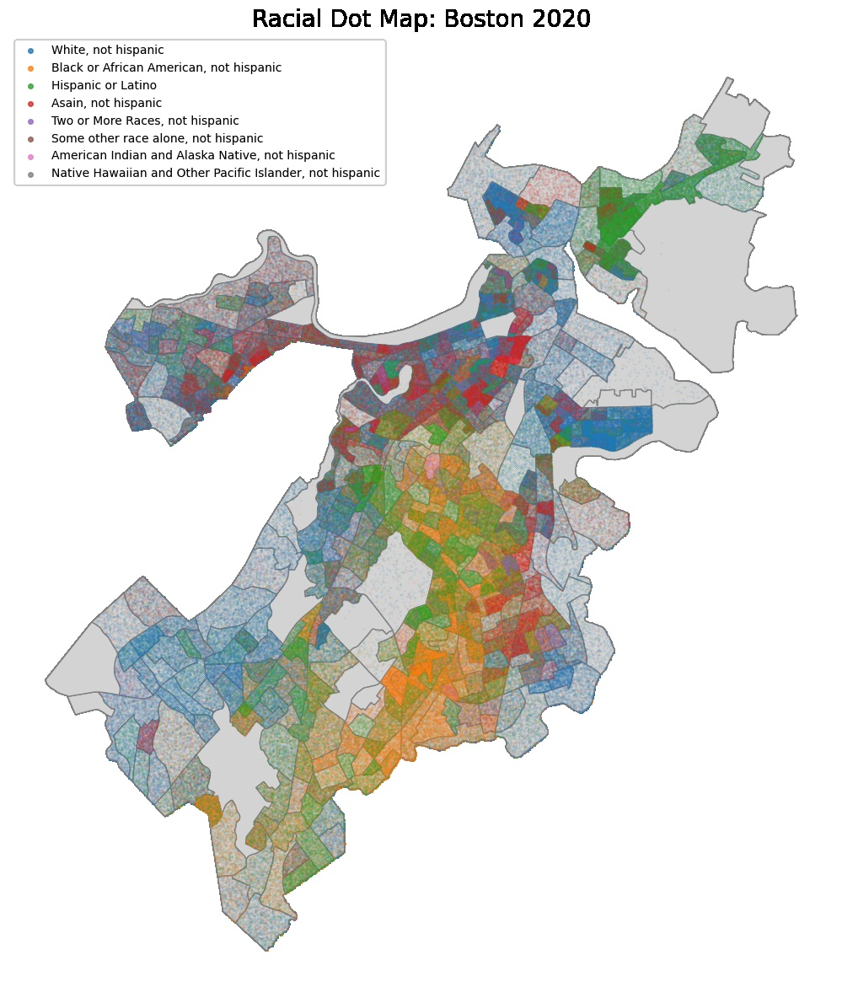
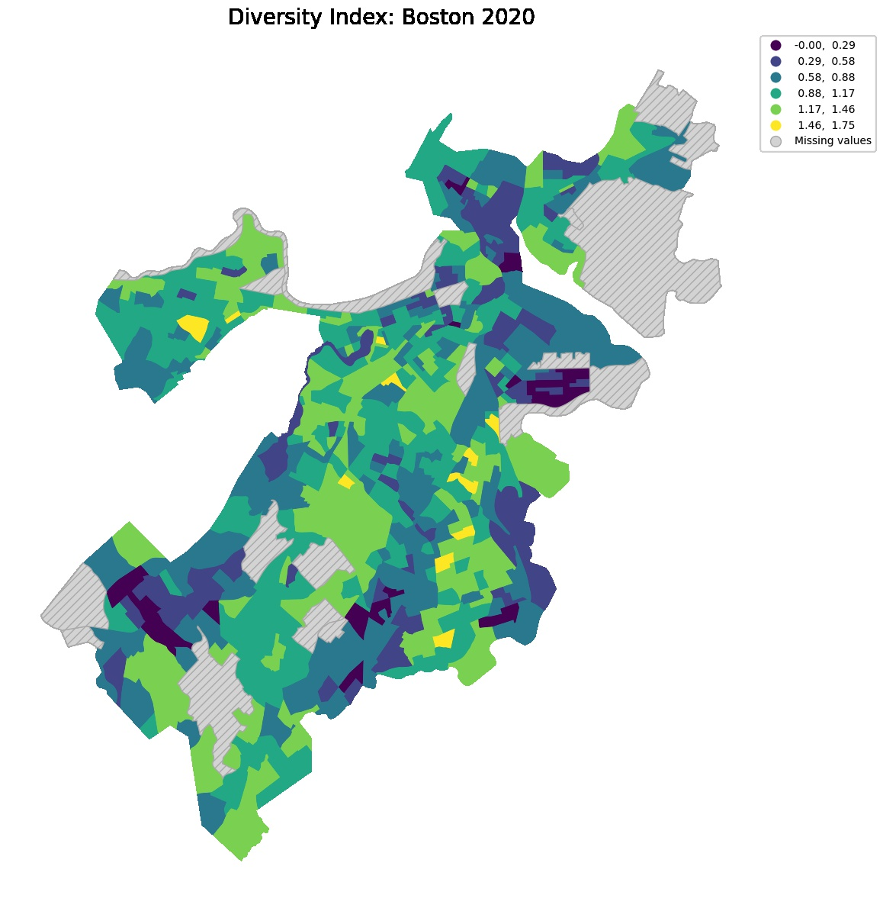
Current Day Boston

Slide 8
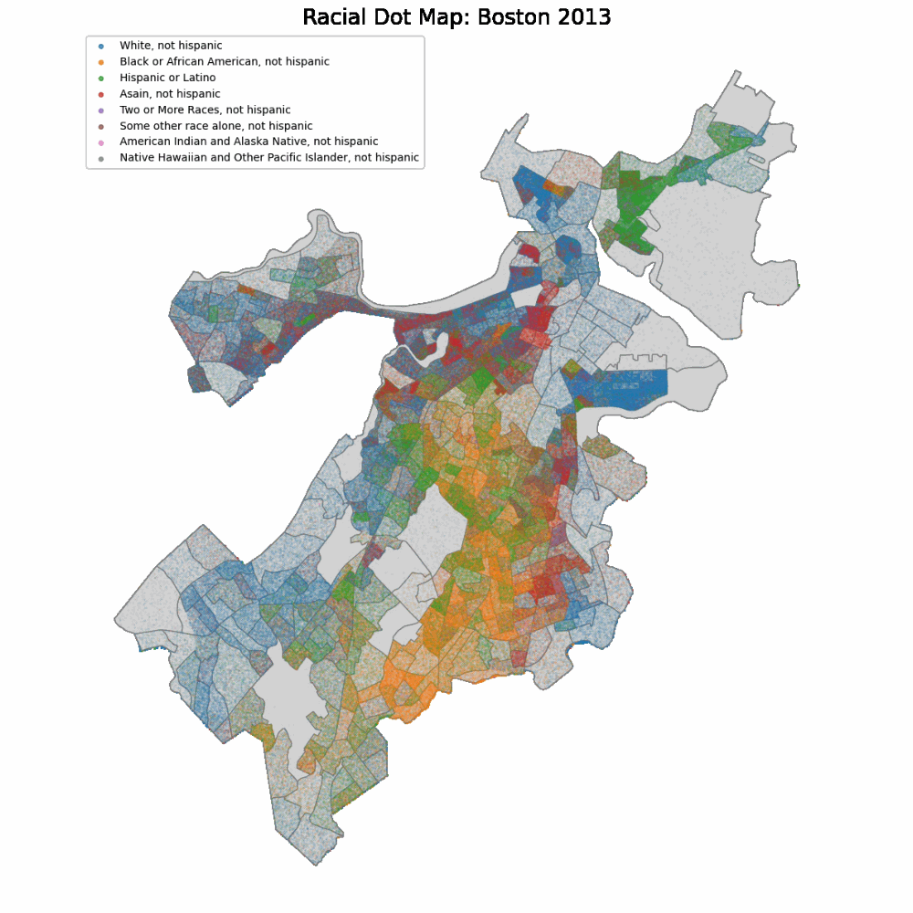
Boston Through the Years
3
1
Highlights:
South Boston has remained predominantly white and Seaport District has increased in white population
Black communities predominantly reside in the southern core of Boston, Dorchester & Roxbury neighborhoods
Large Hispanic & Latino community in East Boston has remained relatively constant over the past 7 years
1
2
3
2

Slide 9
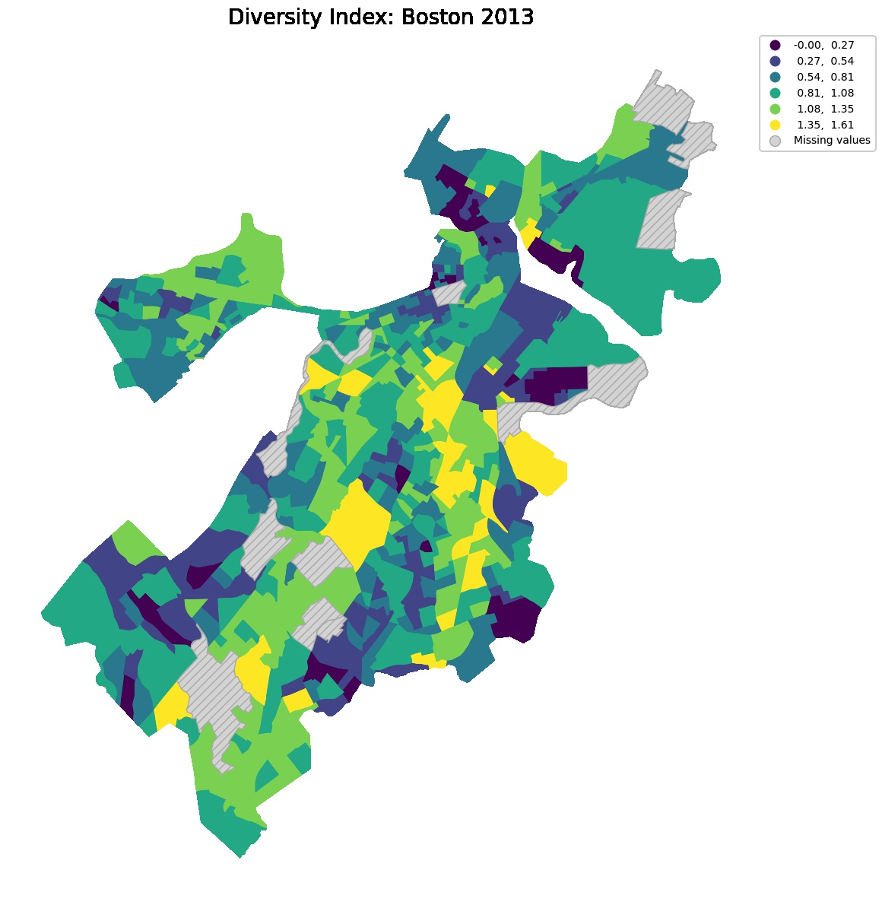
Boston 2013
Boston 2020

Slide 10
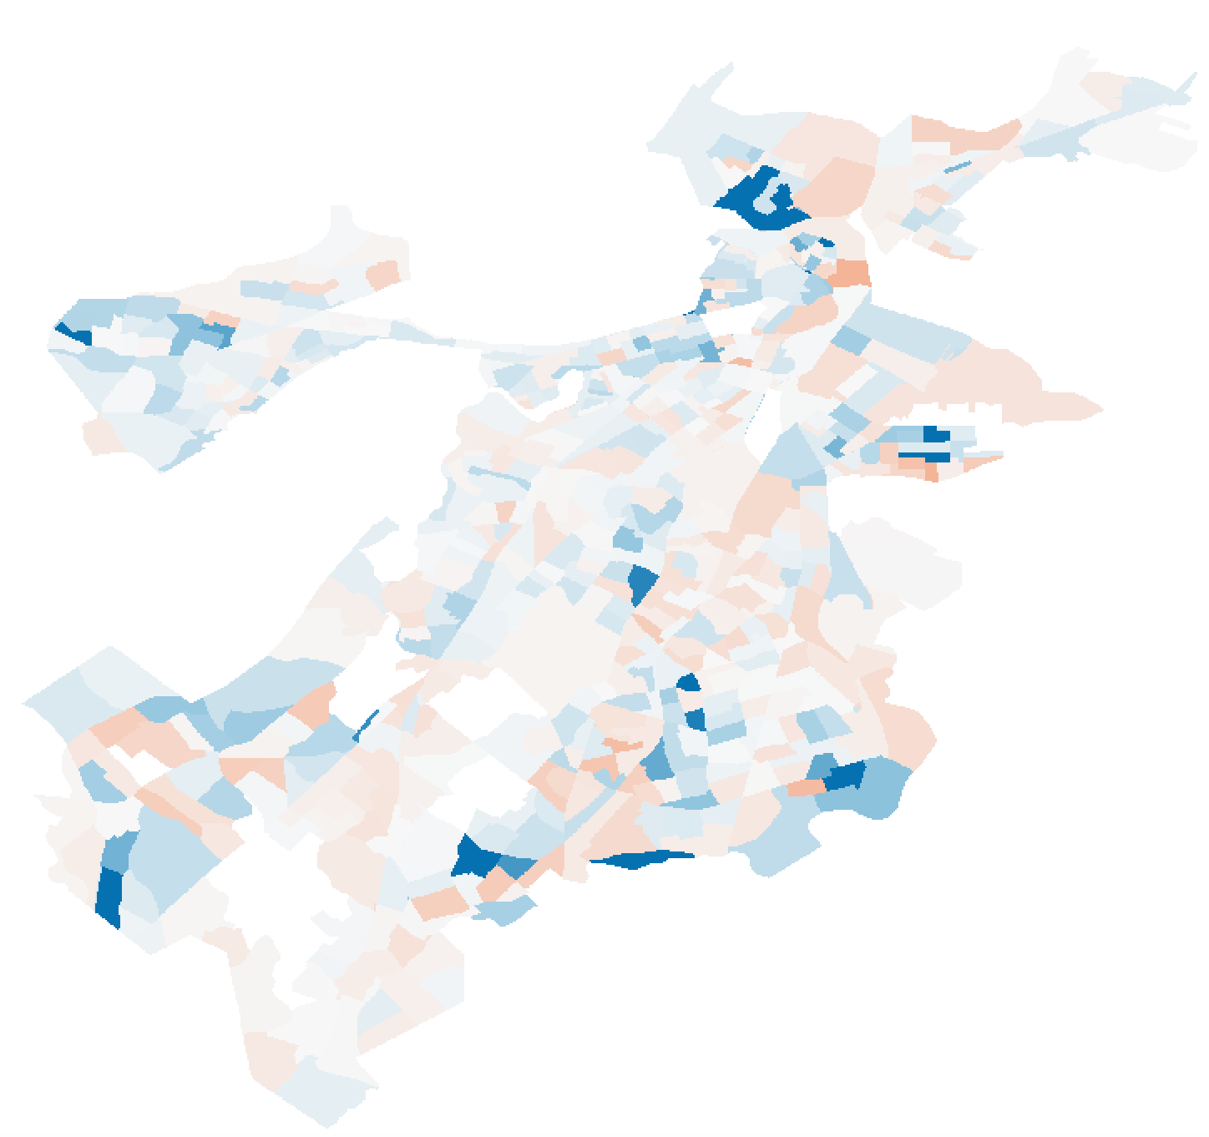
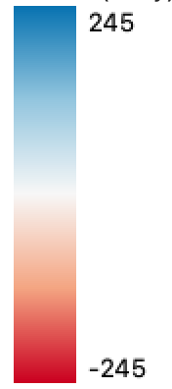
Boston Through the Years
Area of high gentrification & development
The percent change between 2013 & 2020 diversity index shows inconsistent geographic patterns. Mean percent change of +24.3% suggests overall census block groups in Boston have become more diverse on average
Percent Change = (H_{x_20} - H_{x_13}) / H_{x_13}
% Change > 0: H_{x_20} > H_{x_13}
% Change < 0: H_{x_20} < H_{x_13}

Slide 11
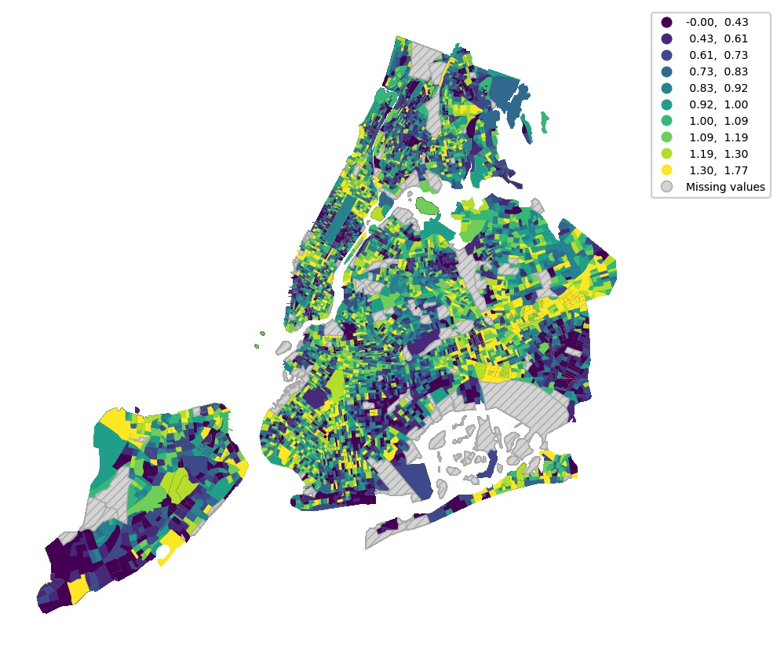
Current Day New York City
Low diversity in:
upper east & west side
East New York, BK
Elmont/Valley Stream (East of JFK)
parts of Staten Island
High diversity in:
Jamaica, Queens
Harlem
Prospect Park North
Notes:
Q for Prof: For diversity index map i excludes census blocks with population of zero. Should I increase this metric? Above 100?

Slide 12
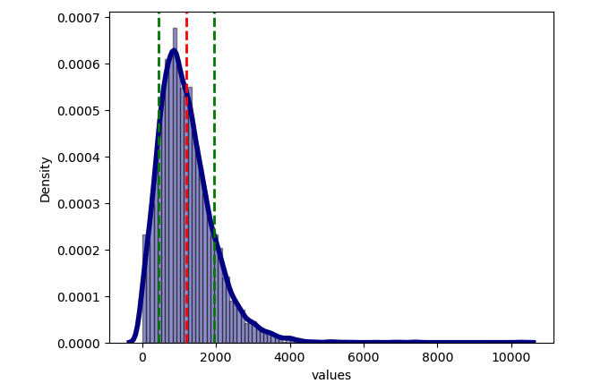
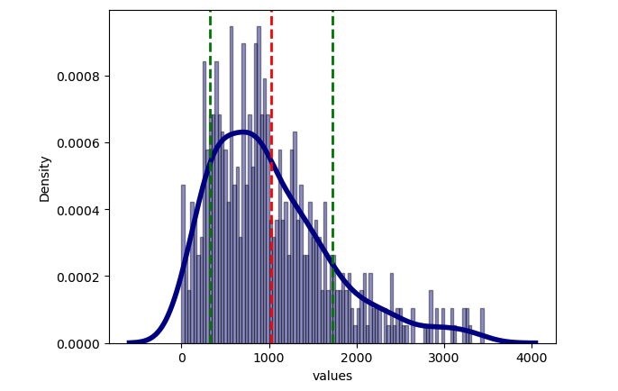
How does Boston Compare to New York City?
Hypothesis: The diversity index of NYC is higher than Boston’s, i.e. NYC is less segregated than Boston.
New York City
Boston
City | Weighted Average of DI
New York City | 1,196.98
Boston | 1,027.22
*Weighted Average of DI = Σ (DI_{i} * population_{i}) / # of census block groups, where i is the index of census block group

Slide 13
How does Boston Compare to New York City?
Hypothesis: The diversity index of NYC is higher than Boston’s, i.e. NYC is less segregated than Boston.
Run a t-test to determine:
H₀: μ_{BOS} = μ_{NYC}
P-value = 0.023, we can reject the null hypothesis
City | Weighted Average of DI
New York City | 1,196.98
Boston | 1,027.22
Run a one sided t-test to determine:
H₀: μ_{BOS} < μ_{NYC}
P-value = 0.999, we cannot reject the null hypothesis
*Weighted Average of DI = Σ (DI_{i} * population_{i}) / # of census block groups, where i is the index of census block group

Slide 14
Conclusions
Diversity Index may not be a comprehensive measurement of segregation
Spatial autocorrelation
Mobility
Racial/ethnic groups in Boston have remained relatively within the same geographical area
On average, census block groups become more diverse in Boston from 2013 to 2020
Weighted average of DI shows that Boston census block groups are significantly less diverse than NYC
Non-weighted average DI shows that we cannot say the averages are unequal

Slide 15
References
[1] The Spotlight Team. (2017, December 10). Boston. racism. image. reality: The spotlight team takes on our hardest question. BostonGlobe.com. Retrieved December 15, 2022, from https://apps.bostonglobe.com/spotlight/boston-racism-image-reality/series/image/
[2]Jensen, E. (2022, June 9). Measuring racial and ethnic diversity for the 2020 census. The United States Census Bureau. Retrieved December 15, 2022, from https://www.census.gov/newsroom/blogs/random-samplings/2021/08/measuring-racial-ethnic-diversity-2020-census.html
[3] Zach. (2022, April 20). Shannon diversity index: Definition & Example. Statology. Retrieved December 15, 2022, from https://www.statology.org/shannon-diversity-index/
[4]R/python - I used python to make a dot density map (with 1 dot per person) for the US decennial censuses from 1990 to 2020. this is over a billion points. the result is an amazing way to visualize population and demographic changes over the last 30 years. I wanted to share the code + process I used. reddit. (n.d.). Retrieved December 15, 2022, from https://www.reddit.com/r/Python/comments/rykx3w/i_used_python_to_make_a_dot_density_map_with_1/
[5] Stepinski, T. F., & Dmowska, A. (2019). Imperfect melting pot–Analysis of changes in diversity and segregation of US urban census tracts in the period of 1990–2010. Computers, Environment and Urban Systems, 76, 101-109. Retrieved from, https://doi.org/10.1016/j.compenvurbsys.2019.04.004.

Slide 16
Data & Analysis
Analysis: https://github.com/lizjohnsoncusp23/MonitoringCitiesFinalProject_DiversityIndex
Data:
U.S. Census Bureau. (2020). 2013-2020 American Community Survey 5-year Hispanic or Latino Origin by Race. Retrieved from, https://data.census.gov/table?q=b03002&tid=ACSDT5Y2020.B03002

